Slide 1
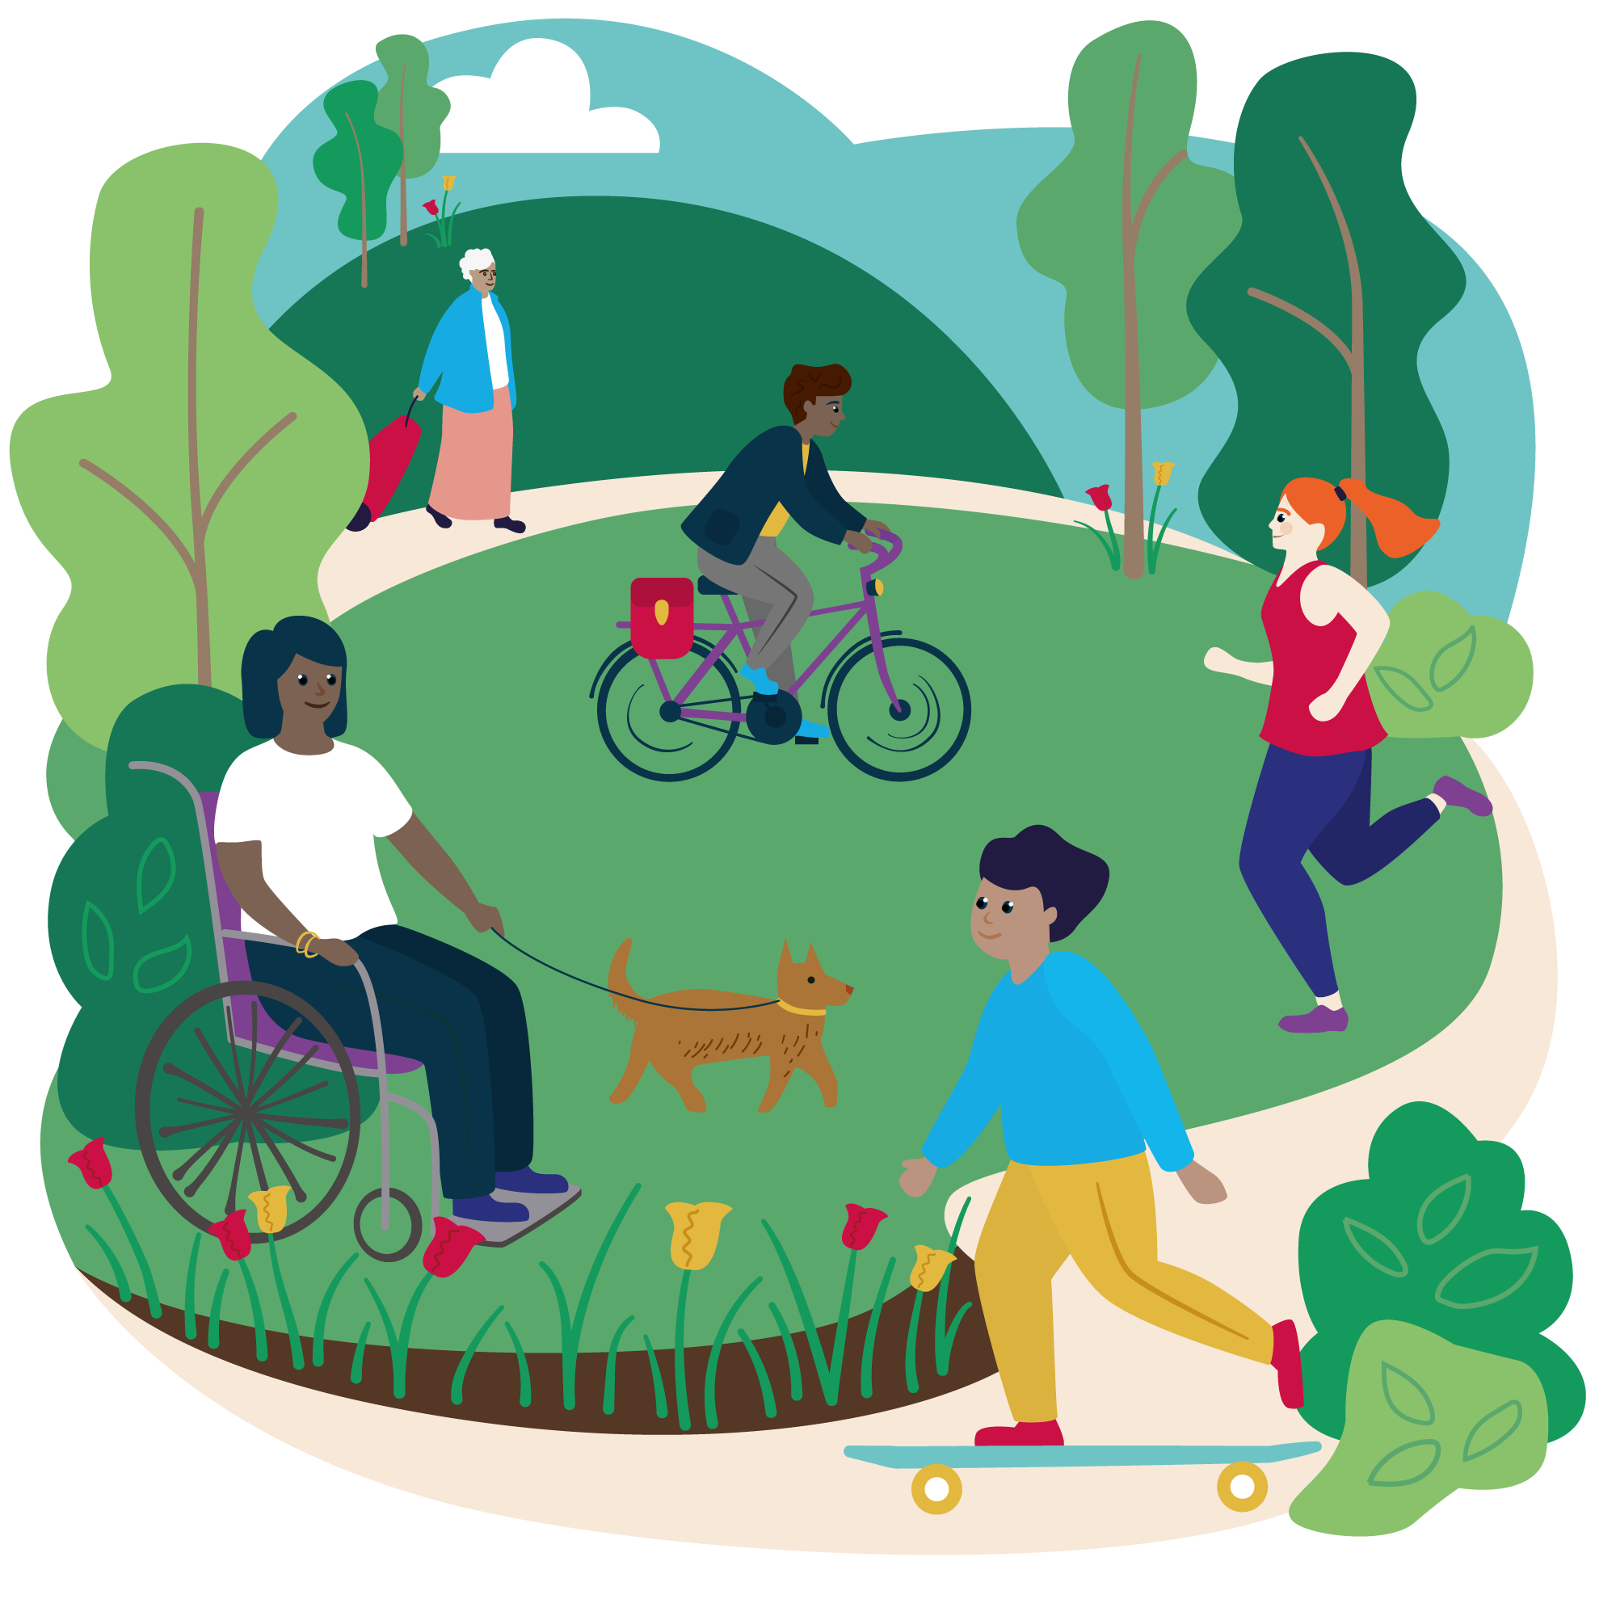

Free and low cost activities in Brentwood
June 2024

Slide 2

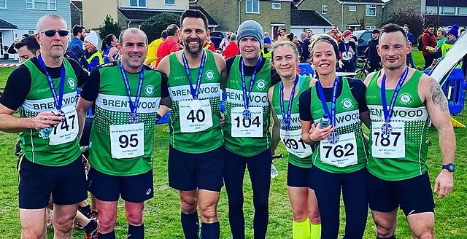

Suggested FREE or Low Cost Activities - Brentwood
FREE OR LOW COST ACTIVITIES AND Walks Move it or Lose It -3 courses running Hutton Community Centre and at Knights Way Centre Classes £7. A third class is 50% funded by Brentwood Council on Thursdays at 1.30 at Bentley Village Hall -£3.50 To register contact Lisa on telephone:07764 390705 or email: lisa.Armstrong@moveitorloseit.co.uk MIND WALKS Thurrock and Brentwood MIND https://thurrockandbrentwoodmind.org.uk) Leaving from Warley MIND on Thursdays at 10am for 1 hour. i ( FREE Health walks daily from Monday to Friday www.brentwood.gov.uk/walking and cycling | HOLISTIC HUB –organised by Social Prescribers Wednesday mornings 9.30-12.30 until December 2023 at @Merrymeade House, Brentwood. FREE Yoga sessions at 11am run by Connie Bedford of @C&B Yoga. No booking needed. RUNNING AND WALKING ACTIVITIES: PARK RUN/ PARK WALK - Free 5k timed weekly walk or running event Check the website for your local Brentwood Park Walk/Park Run EVERY SATURDAY (ADULTS) in South Weald Park and Junior Park Run/walk on Hutton Recreation Ground, Hutton, 9.00 on SUNDAYS. Need to download bar code to take part. Some local events - Billericay Chelmsford and Hockley - run a group for people living with and beyond Cancer at their local park run – last Saturday of every month. This does not seem to be available for Brentwood. www.5kyourway.org Brentwood Running Club https://www.brentwoodrunningclub.co.uk Brentwood Beagles Athletics Club https://www.beagles.org.uk Thorndon Walking & Running Club Contact Donna on 07876 336948 or Su on 07914641199 Tri Sport Essex Suitable for age 8+- offering running, swimming, cycling, triathlon https://trisportessex.org June 2024 Billericay Striders Running Club - Family Friendly Running Club

Slide 3

Suggested FREE or Low Cost Activities - Brentwood
FREE community activities in Brentwood Go Jauntly App –Download the FREE app for lots of walks, local to where you are free of charge. Exploring the wonderful country parks – Thorndon Country Parks (Gruffalo Trail – Thorndon North), South Weald, Warley Place and other Essex Parks. Buy the Essex Explorer Pass for use in all Essex County Council parks for 1 year. £75 standard pass, Over 65’s and concessions £52 Park Run - Weald Park on Saturdays and Hutton Recreation Ground Junior Park Run on Sundays in Hutton. https://parkrun.org.uk | Little Fishes, Daily Bread Café, Hutton For babies and Pre-School aged children Term Time Thursdays 9.30-11am No need to book – all children and their carers welcome Contact: office@huttonparish.com Who Let the Dads Out Hutton & Shenfield Union Church, Roundwood Avenue, CM13 2NA 1st Saturday of the month for 0-5 year olds and their dads, grandads, male carers. Time 10-13.00 No need to book. Just turn up and play. Donation box only. Dad’s Café, Hutton and Shenfield Union Church, Roundwood Avenue, CM13 2NA Every Saturday of 2023 at 9-12am for Dads and babies under 2 years old No need to book. Just turn up. Red Balloon Foundation – donation only events including those at Hutton & Shenfield Union Church and Brentwood Baptist Church https://www.rbf.org.uk r events | parkrun U
June 2024

Slide 4


Suggested FREE or Low Cost Activities - Brentwood
POPULAR WITH OLDER ADULTS Over 50s Activity Clubs: Strollercise Brentwood 50’s & 60’s music https://www.strollercise.co.uk/strollercisebrentwood All classes £5. Every day Monday – Friday at various Brentwood locations Bennetts Community Tea Dance , Nightingale Centre, Warley, Brentwood Monthly on 3rd Wednesday between 2-4pm £5pp including cuppa and cake SEN and Dementia friendly Email: info@bennettsfunerals.co.uk Kazen Kai Centre, Bannister Drive, Hutton https://www.kazenkai.com Low Impact Fitness for the Elderly Tuesdays & Thursdays 13.15-14.00 £6 per class run by Emma2 June 2024 | SHORT MAT BOWLS Plenty of local clubs offering short mat bowls including Hutton Community Centre 50+ Club, £5 per annum membership plus £2 per session https://huttoncommunitycentre.com £ ZUMBA GOLD Lower impact version of this popular dance workout https://www.zumba.com Running at Hutton Community Centre on Tuesdays at 12.45pm and Fridays at 1pm. Cost £4 per class. No booking needed. £5£5 per annum membership and 32 per sess Short Mat Bowls Club, Billericay (hugofox.co U3A (UNIVERSITY OF THE THIRD AGE), 3 different Brentwood Groups Activities for retired people led by members so activities are lower Cost. Small yearly membership fee applies and costs for individual events as appropriate. https://www.huttonu3a.org.uk https://alexanderhost.org.uk https://u3asites.org.uk/shenfield

Slide 5
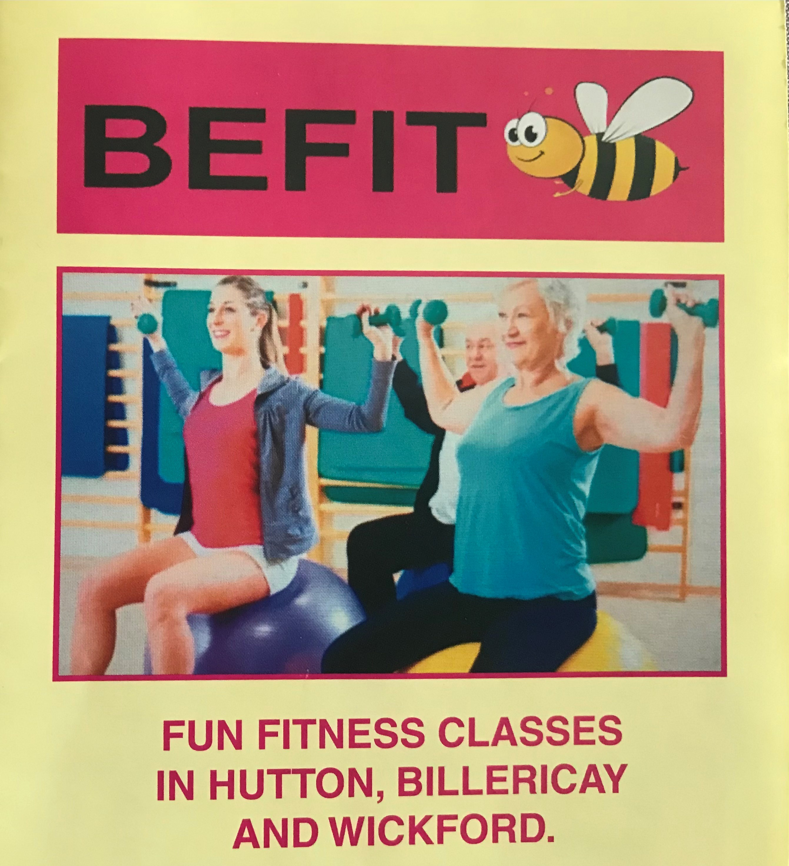
Suggested FREE or Low Cost Activities - Brentwood
£ | POPULAR CLASSES (FEES APPLY) Clubbercise and Boxercise Led by various people Eg cezara.bokwa@yahoo.co.uk @carolinefrydfitness Find a Class - Move it or Lose Health Fitness & Kinesiology South Weald Parish Hall, London Road, CM14 4NP - Gill Bauer £5 per health &fitness class, £6 Qigong, £7 Yoga Nidra E-mail: gill.bauer@btinternet.com Befit Fitness Brentwood and Billericay Fun, total body workout, seated exercises E-mail: LesleyBfit@mail.com Please contact me for other ideas of paid for clubs and classes June 2024
C & B Yoga
Various yoga classes including Pre & Post Natal, kids & teens
Contact Connie Bedford: 07393 866507 or email:connie@candbyyoga.com
SWFIT Pilates
Various pilates classes around the area including for Musculo Skeletal conditions
Email contact:swfit4@yahoo.com

Slide 6
Suggested FREE or Low Cost Activities - Brentwood
INCLUSIVE ACTIVITIES www.activeessex.org/find-your-active/- FREE ONLINE CLASSES workout-channel/ES Football Club SNAP - Special Needs And Parents. For families with children with additional needs aged 0-25 https://www.snapcharity.org Therapy, Exercise, Active M.S. Essex (T.E.A.M.S Essex) E-mail: t.e.a.ms@outlook.com or Jaci on 07366 395 847 Or Tina on 07939 941159 Thurrock and Brentwood MIND https://thurrockandbrentwoodmind.org.uk Autistic Football Club https://autisticfc.com RLFC EELS https://linktr.ee/www.brentwoodrlfc.co.uk Email: info@brentwoodrlfc.co.uk (men,women, boys, girls & wheelchair rugby) Aqua Mobility Swimming (Monday – Friday) Brentwood Leisure Trust https://everyoneactive.com BASIS, the Reading Rooms, High Street, Billericay Keep Fit for visually impaired, coffee 2nd hour(low impact) 10-12midday on Tuesdays (£2.50 for the session) https://www.basissouthessex.org.uk/activities/billericay/ | SPORT FOR CONFIDENCE – Brentwood Centrert For Confidenhttps://www Various inclusive activities £3.50 per session https://www.sportforconfidence.com WheelPower Online Exercise Classes https://wheelpower.org.uk Essex Activate School holiday programme – food and activity. Some clubs dedicated to those with extra needs. https://www.activeessex.org TRAILNET Thorndon Park Inclusive Cycling. CM13 3RZ For children and adults. All types of bike hire too as well as SEND days https://www.Trailnet.org.uk/inclusive-cycling.html Telephone 07939 249980 GREAT DANES Football Club Inclusive sport sessions Saturday mornings 9am Age Youth and Young adults suitable for multiple impairments https://gtdanessyfc.co.uk Essex Youth Service Endeavour Youth Club (age 13 -25 years-children with special educational needs) Tuesday eve 6.30-8.30pm Contact Claire Love on 07919 624935 or email:Claire.love@essex.gov.uk
Feb 24

Slide 7

Suggested FREE or Low Cost Activities - Brentwood
Sports Centres and Community Centres Brentwood Centre, Pilgrims Hatch, CM15 9NN https://www.everyoneactive.com Telephone 01277 215151 Huge variety of activities and classes available. Free membership card and costs apply for activities Better Gym, Baytree Centre, CM14 4BX https://www.better.org.uk Newly refurbished Barbell Girls, Oakleigh Farm, Rayleigh Road, Hutton Weight training for women https://m.facebook.com/barbellgirls.com Telephone number: 07736 279568 E-mail: BarbellGirls@hotmail.com £6 per session | Hutton Community Centre, Harrison Close, Hutton https://www.huttoncommunitycentre.com Telephone number: 01277 231600 Wide choice of classes – 35 in total Knights Way Centre, Knights Way, Hutton https://www.knightswaycentre.co.uk Telephone number:01277 220510 (phones not manned a lot of the time) – best to e-mail: info@knightswaycentre.co.uk Wide range of activities in centre Ingatestone & Fryerning Community Association, High Street, Ingatestone Lots of local activities https://www.ifcc.org.uk Ongar Leisure Centre https://placesleisure.org Bishop’s Hall Community Centre, Pilgrims Hatch https://www.brentwood.gov.uk
June24

Slide 8
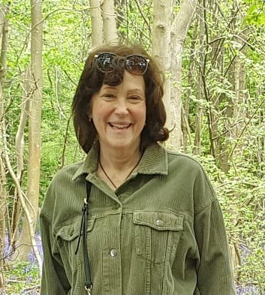

Suggested FREE or Low Cost Activities - Brentwood
Carol Wakeman Community Connector for Brentwood Working as part of Active Essex ‘findyouractive’ campaign. HOW I CAN HELP? Promote activities through our Facebook and Instagram pages ‘findyouractivebrentwood’ and within the community Signpost individuals to an activity Come along to and promote your activities Provide pop ups for organisations and the public June 2024 | If you would like any help to find local activities as this is not a comprehensive list: PLEASE JOIN: https://www.facebook.com/FindYourActiveBrentwood Please message me via my Facebook page or email: cwakeman@atfcommunity.com Or phone me on 07858 372323 (I work part time so will get back to you as soon as is possible) Search and add activities for free here https://www.activeessex.org/activity-finder/

